Slide 1


Digital System Design
Course
Professor: Jaime Velasco-Medina
Bionanoelectronics Group

Slide 2



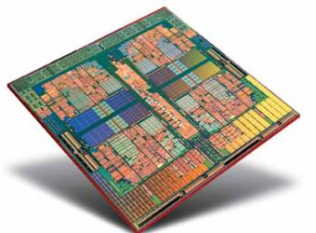
Digital System Design
Course

Slide 3
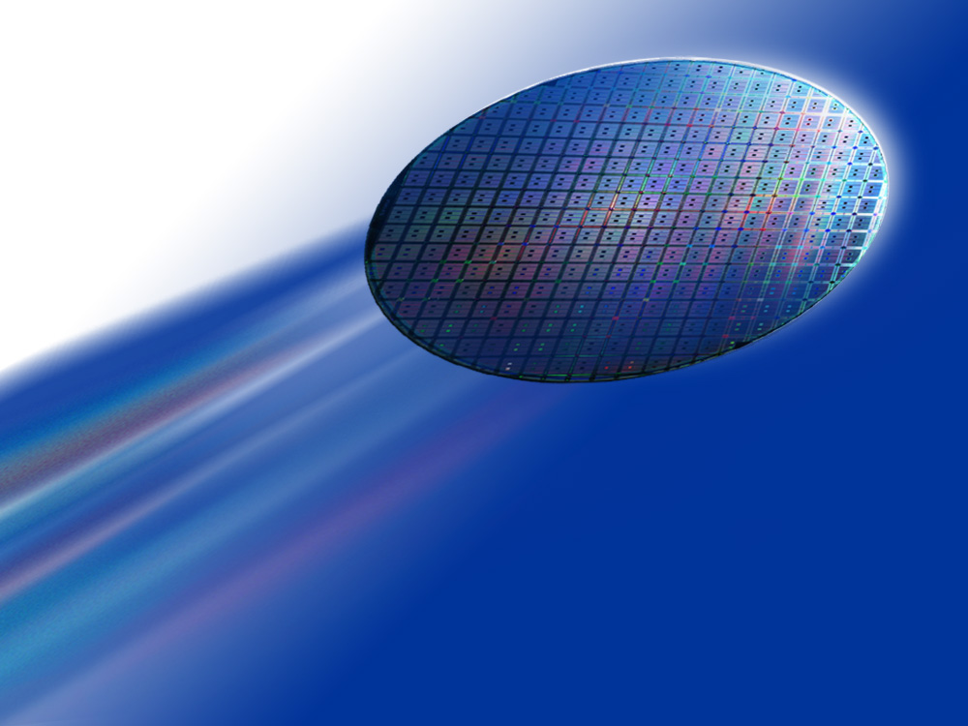


Digital System Design Course
Notes:
In order to use your VHDL or Verilog with SOPC Builder, . . .

Slide 4
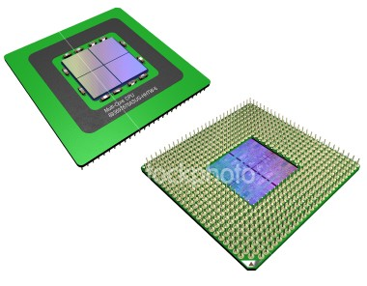


Finite States Machine
Design
FSM
Lecture 10-0

Slide 5

Multiplier Design

Slide 6
1. Binary Multiplier
algorithm
Start
S1
C, A  0
M  Multiplicand
Q  multiplier
Count  # n
0
Q₀ = 1
1
S2
C, A  A + M
S3
A, Q  Shr C, A, Q
Count  Count - 1
0
Cnt = 0
1
End
Product in A, Q

Slide 7
1. Binary Multiplier
Datapath especifico
B
n
n
Cout
+/-
n
C
A
Q
Q₀

Slide 8
1. Binary Multiplier
ASM diagram
Start
C, A  0
B  Multiplicand
Q  multiplier
Count  # n
1
0
Q₀ = 1
1
2
C, A  A + B
3
A, Q  Shr C, A, Q
Count  Count - 1
0
Cnt = 0
1
End
Product in A, Q

Slide 9
Multiplication
ASM diagram
IDLE
0
START
B ← Multiplicando
Q ← multiplicador
A ← 0
Cnt ← n
1
No
Qo=1
Si
A ← A + B
2
No
3
A,Q ← Shr (C, [A,Q])
Cnt ← Cnt-1
Cnt=0
Si
END

Slide 10

Multiplication
ASM diagram
IDLE
Algoritmo → Procesador UV2009
0
START
B ← Multiplicando
Q ← multiplicador
A ← 0
Cnt ← n
1
No
Qo=1
2
Si
A ← A + B
3
No
4
A,Q ← Shr (C, [A,Q])
Cnt ← Cnt-1
Cnt=0
Si
END

Slide 11
Multiplication
BUS A
BUS B
Data-Out
REG B
REG A
R OUT
R₀
R₁
Address
ALU
V
S
Z
C
RAM
REG
Data
SHIFTER
R₇
R IN
REG C
Data-In
BUS C
Procesador UV2009

Slide 12
Multiplicación
1. Cargar Datos
Registros a usar:
R0 = B (dato 1: multiplicando)
R4 = Q (dato 2: multiplicador)
R7 = Q (PL)
R6 = A (PH)
R1, R2 y R3 = Registros auxiliares
B ← Multiplicando
Q ← Multiplicador
A ← 0
Cnt ← n
1
Rin ← M[500] (dato1)
R0 ← Rin
R4 ← (dato 2)
R6 ←0, R7 ←0, RA ← 0, RB ← 0
Cnt ← n
1

Slide 13
Multiplicación
2. Determinar Qo
Q₀ = 1
2
RA ← R4, RB ← 0
RC ← Shr ([RA + RB], 0)
R1 ← RC
RA ← R1, RB ← 0
RC ← Shl ([RA + RB], 0)
R1 ← RC
RA ← R4, RB ←R1
RC ← R4 - R1
Entonces:
Si R4 - R1 = X, C=1
R4 - R1 = X, C=0
C=1, → Qo=0
C=0, → Qo=1
2

Slide 14
Multiplicación
2. Determinar Qo
Q₀ = 1
2
RA ← R4, RB ← 0
RC ← Shr ([RA + RB], 0)
R1 ← RC
RA ← R1, RB ← 0
RC ← Shl ([RA + RB], 0)
R1 ← RC
RA ← R4, RB ←R1
RC ← R4 - R1
Entonces:
Si R4 - R1 = 0, Z=1
R4 - R1 = 1, Z=0
Z=1 → Qo=0
Z=0 → Qo=1
2

Slide 15
Multiplicación
3. Sumar
3
A ← A + B
RA ← R6, RB ← R0
RC ← RA + RB
R6 ← RC
3

Slide 16
Multiplicación
4. Rotar AQ con el carry [C]
A, Q ← Shr (C, [A,Q])
Cnt ← Cnt-1
4
1. Evaluar bit carry de operación: RC ← RA + RB
Si C=0:
RA ← R6, RB ← 0
RC ← Shr ([RA + RB], 0)
R2 ← RC
Si C=1:
RA ← R6, RB ← 0
RC ← Shr ([RA + RB], 1)
R2 ← RC
4

Slide 17
Multiplicación
4. Rotar AQ con el carry [C]
A, Q ← Shr (C, [A,Q])
Cnt ← Cnt-1
4
2. Evaluar bit R6[0]
RA ← R6, RB ← 0
RC ← Shr ([RA + RB], 0)
R3 ← RC
RA ← R3, RB ← 0
RC ← Shl ([RA + RB], 0)
R3 ← RC
RA ← R6, RB ← R3
RC ← R6 – R3
4

Slide 18
Multiplicación
4. Rotar AQ con el carry [C]
A, Q ← Shr (C, [A,Q])
Cnt ← Cnt-1
4
3. Evaluar bit zero de operación: RC ← R6 + R3
Si Z=0 (R6[0]=1):
RA ← R4, RB ← 0
RC ← Shr ([RA + RB], 1)
R4 ← RC, R7 ← RC
RA ← 0, RB ← 0
Cnt ← Cnt – 1
Si Z=1 (R6[0]=0):
RA ← R4, RB ← 0
RC ← Shr ([RA + RB], 0)
R4 ← RC, R7 ← RC
RA ← 0, RB ← 0
Cnt ← Cnt – 1
4

Slide 19
Calcular LSB. v1
Calcular LSB [R0] = R0₀
1. R0_{n-1} = 0 Raux > R0
2. R0_{n-1} = 1 Raux ≤ R0
R0 111100
R_{aux} 111100
shr,0 011110
shl,1 111101
R0 111100
R_{aux} 111101
111111
R0 110111
R_{aux} 110111
shr,0 011011
shl,1 110111
R0 110111
R_{aux} 110111
000000
→
→
←
←
-
-
C = 1 → LSB = 0
C = 0 → LSB = 1

Slide 20
Calcular MSB: v1
Calcular MSB [R0] = R0_{n-1}
1. R0_{n-1} = 0 Raux > R0
2. R0_{n-1} = 1 Raux ≤ R0
R0 011011
R_{aux} 100000
R0 011011
R_{aux} 100000
111011
R0 110101
R_{aux} 100000
R0 110101
R_{aux} 100000
010101
-
-
C = 1 → MSB = 0
C = 0 → MSB = 1

Slide 21
Calcular LSB: v2 (ALU)
Calcular LSB [R0] = R0₀
1. R0_{n-1} = 0 Raux = 1
2. R0_{n-1} = 1 Raux = 1
R0 101100
R_{aux} 000001
000000
R0 100111
R_{aux} 000001
000001
And
And
Z = 0 → LSB = 0
Z = 1 → LSB = 1

Slide 22
Calcular MSB: v2
Calcular MSB [R0] = R0_{n-1}
1. R0_{n-1} = 0 Raux = R0
2. R0_{n-1} = 1 Raux ≤ R0
R0 011011
R_{aux} 011011
R_{aux} 0 110110
R0 110101
R_{aux} 110101
R_{aux} 1 101010
+
+
C = 0 → MSB = 0
C = 1 → MSB = 1
R1 ← R0 + R0 ⇒ Shl(R0)

Slide 23
Square Root Design: √X

Slide 24
Raíz cuadrada
IDLE
S0
NO
START
Algoritmo: diagrama ASM1
YES
S1
D ← Radicando
A ← 0; Q ← 0
Cnt ← n/2
S2
A,D ← Shl(2) A,D
Cnt ← Cnt - 1
S3
A ← A - Q,01
=0
Cout
=1
S5
S4
A ← A + Q,01
Q ← Shl Q
Q_{LSB} ← 1
S6
Q ← Shl Q,
Q_{LSB} ← 0
NO
Z_{CNT}
YES
END

Slide 25
Raíz cuadrada
Algoritmo: diagrama ASM2
IDLE
0
START
D ← Radicando
A ← 0, Q ← 0
Cnt ← n/2
1
2
A,D ← Shl ([A,D] , 0) x 2
Cnt ← Cnt-1
3
A ← A – [Q,01]
4
No
C=1
Si
Q ← Shl Q, 1
Zcnt=1
No
6
Si
5
A ← A + [Q,01]
Q ← Shl Q, 0
END

Slide 26
Raíz cuadrada
Datapath especifico
Q
n/2
1
0
ALU
n/2+2
Cout
n/2+2
C
A
D
n/2+2
n

Slide 27
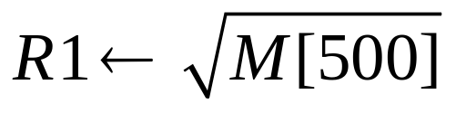
Raíz cuadrada
IDLE
Algoritmo → Procesador UV2009
0
START
D ← Radicando
A ← 0, Q ← 0
Cnt ← n/2
1
2
A,D ← Shl ([A,D] , 0) x 2
Cnt ← Cnt-1
3
A ← A – [Q,01]
4
No
C=1
Si
Q ← Shl Q, 1
Zcnt=1
No
6
Si
5
A ← A + [Q,01]
Q ← Shl Q, 0
END

Slide 28
Raíz cuadrada
BUS A
BUS B
Data-Out
REG B
REG A
R OUT
R₀
R₁
Address
ALU
V
S
Z
C
RAM
REG
Data
SHIFTER
R₇
R IN
REG C
Data-In
BUS C
Procesador UV2007

Slide 29
Raíz cuadrada
1. Cargar datos
Determinar los registros a usar:
R0 = D (dato1: radicando)
R1 = Q
R2 = A
R3 y R6 = Registros auxiliares
D ← Radicando
A ← 0, Q ← 0
Cnt ← n/2
1
Rin ← M[500]
R0 ← Rin
R1 ←0, R2 ←0
Cnt ← n/2
1

Slide 30
Raíz cuadrada
2. Doble desplazamiento del registro A,D
R0 = D = 0110
R1 = Q
R2 = A
R3 y R6 = Reg Auxiliar
2
A,D ← Shl ([A,D] , 0) x2
Cnt ← Cnt-1
RA ← R0, RB ← 0
RC ← Shr (RA, 0)
R3 ← RC
RA ← R3, RB ← 0
RC ← Shr (RA, 0)
R3 ← RC
RA ← R2, RB ← R2
RC ← Shl ([RA +RB], 0)
R2 ← RC
RA ← R2, RB ← R3
RC ← RA + RB
R2 ← RC
RA ← R0, RB ← R0
RC ← Shl ([RA +RB], 0)
R0 ← RC
Cnt ← Cnt – 1
2

Slide 31
Raíz cuadrada
Si C = 1 (A ≥ [Q,01])
4
3
A ← A - [Q,01]
C=1
Si
Q ← Shl Q, 1
RA ← R1, RB ← R1
RC ← Shl ([RA + RB], 1)
R6 ← RC
RA ← R2, RB ← R6
RC ← RA – RB
R3 ← RC
RA ← R1, RB ← 0
RC ← Shl ([RA + RB], 1)
R1 ← RC
4
3

Slide 32
Raíz cuadrada
Si C = 0 (A < [Q,01])
C=1
No
6
5
A ← A + [Q,01]
Q ← Shl Q, 0
RA ← R2, RB ← R1
RC ← RA + RB
R2 ← RC
RA ← R1, RB ← 0
RC ← Shl ([RA + RB], 0)
R1 ← RC
5
6

Slide 33
Raíz cuadrada
IDLE
Algoritmo → Procesador UV2009
0
START
D ← Radicando
A ← 0, Q ← 0
Cnt ← n/2
1
2
A,D ← Shl ([A,D] , 0) x 2
Cnt ← Cnt-1
3
A ← A – [Q,01]
4
No
C=1
Si
Q ← Shl Q, 1
Zcnt=1
No
6
Si
5
A ← A + [Q,01]
Q ← Shl Q, 0
END

